Slide 1
Graphical User Interface (GUI)
Object Oriented Development
with Java
(CT038-3-2 and Version VC1)
GUI-based Development

Slide 2
Topic & Structure of the lesson
AWT vs Swing
Swing components
Creating a window
Adding components
Handling action events

Slide 3
Learning outcomes
At the end of this lecture you should be able to:
Differentiate between AWT and Swing
Create a Window
Understand GUI Classes in a main method
Radio Buttons and Check Boxes
Focus on Problem Solving: Extending Classes from Jpanel

Slide 4
Key terms you must be able to use
If you have mastered this topic, you should be able to use the following terms correctly in your assessments:
AWT
Swing

Slide 5
Introduction
A GUI is a graphical window or windows that provide interaction with the user
GUIs accept input from:
the keyboard
a mouse
A window in a GUI consists of components that:
present data to the user
allow interaction with the application

Slide 6
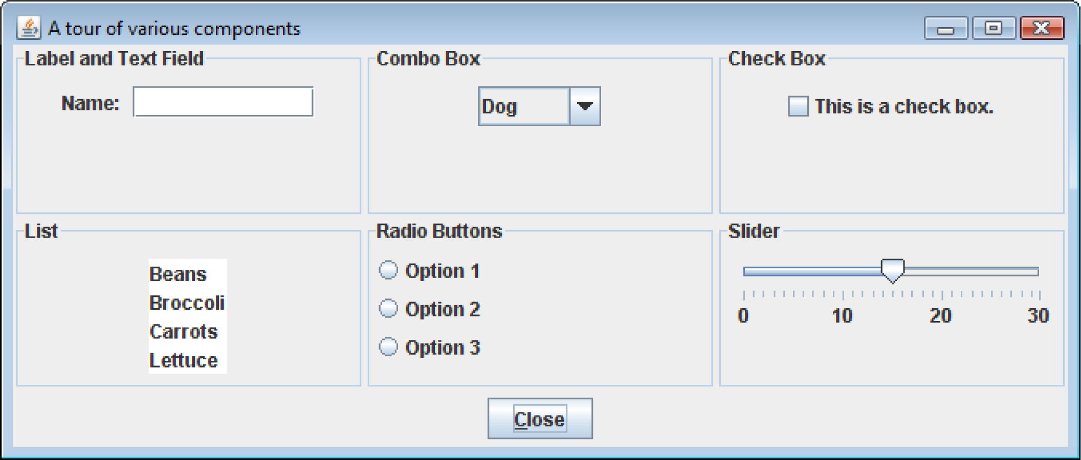
Introduction
Some common GUI components are:
buttons, labels, text fields, check boxes, radio buttons, combo boxes, and sliders.

Slide 7
Introduction
Java is equipped with a set of classes for drawing graphics and creating graphical user interfaces
These classes are part of the Abstract Window Toolkit (AWT)

Slide 8
Abstract Window Toolkit (AWT)
The AWT allows creation of applications and applets with GUI components
Java programs using the AWT:
look consistent with other applications on the same system
can offer only components that are common to all the operating systems that support Java

Slide 9
Swing
Swing is a library of classes that provide an improved alternative for creating GUI applications and applets
Part of Oracle’s Java Foundation Classes (JCF)
Developed to provide a more sophisticated set of GUI components than AWT
Swing components have a consistent look and predictable behavior on any operating system
Swing components can be easily extended

Slide 10
Event Driven programming
Programs that operate in a GUI environment must be event-driven
An event is an action that takes place within a program, such as the clicking of a button
Part of writing a GUI application is creating event listeners
An event listener is an object that automatically executes one of its methods when a specific event occurs

Slide 11
javax.swing and java.awt
In an application that uses Swing classes, it is necessary to use the following statement:
import javax.swing.*;
In an application that uses an AWT class, it is necessary to use the following statement.
import java.awt.*;

Slide 12
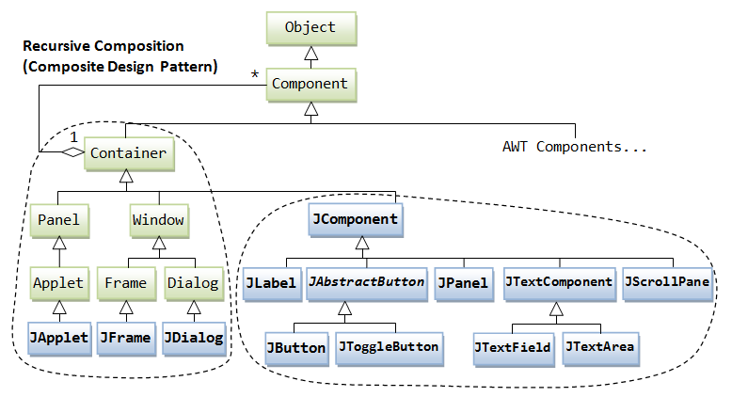
Swing Components
Two classes: Container and Component
Container holds components and/or containers
Image Source: https://www.ntu.edu.sg/home/ehchua/programming/java/J4a_GUI.html#zz-10.

Slide 13
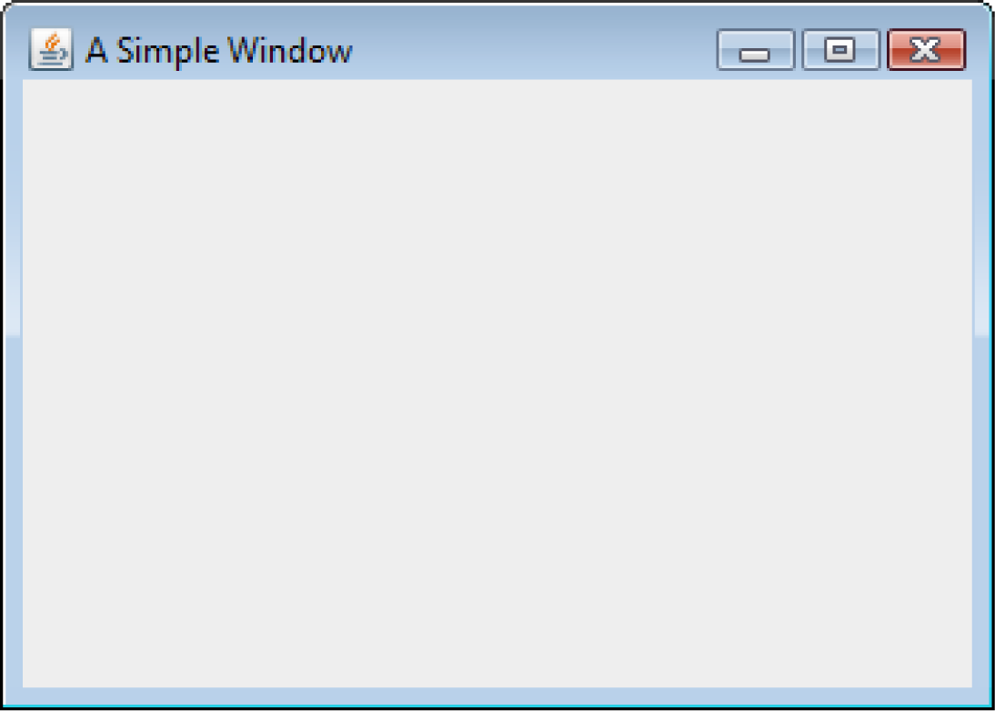
Creating a window in Swing
A window is a container, which is simply a component that holds other components
A container that can be displayed as a window is a frame
In a Swing application, you create a frame from the JFrame class (top-level container)
javax.swing.JFrame
This is a content pane.
Java components are added here.

Slide 14
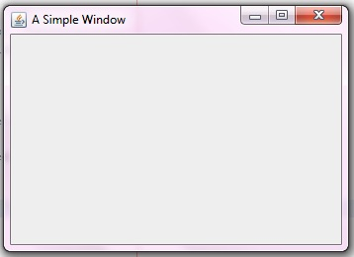
Creating a window
import javax.swing.*; // Needed for Swing classes
public class ShowWindow
{
public static void main(String[] args)
{
// Window width and height in pixels
final int WINDOW_WIDTH = 350;
final int WINDOW_HEIGHT = 250;
JFrame window = new JFrame(); // Create a window
window.setTitle("A Simple Window"); // Set the title
window.setSize(WINDOW_WIDTH, WINDOW_HEIGHT); // Set the size of //the window
// Specify what happens when the close button is clicked
window.setDefaultCloseOperation(JFrame.EXIT_ON_CLOSE);
window.setVisible(true); // Display the window
}
}

Slide 15
Creating a window Extending JFrame
import javax.swing.*; // Needed for Swing classes
public class SimpleWindow extends Jframe {
/* Constructor */
public SimpleWindow() {
final int WINDOW_WIDTH = 350; // Window width in pixels
final int WINDOW_HEIGHT = 250; // Window height in pixels
setTitle("A Simple Window"); // Set this window's title
setSize(WINDOW_WIDTH, WINDOW_HEIGHT); // Set the size of //this window
// Specify what happens when the close button is clicked.
setDefaultCloseOperation(JFrame.EXIT_ON_CLOSE);
setVisible(true); // Display the window
}
}
Note: You will need to create a main program to run this code

Slide 16
Adding Components
Swing provides numerous components that can be added to a window.
Swing components begin with a J
Three fundamental components are:
JLabel: An area that can display text
JTextField : An area in which the user may type a single line of input from the keyboard
JButton: A button that can cause an action to occur when it is clicked

Slide 17
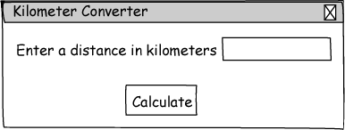
Adding Components
Text Field
Window Title
Label
Button

Slide 18
Adding Components
private JLabel message;
private JTextField kilometers;
private JButton calcButton;
…
message = new JLabel("Enter a distance in kilometers");
kilometers = new JTextField(10);
calcButton = new JButton("Calculate");

Slide 19
Adding Components
A content pane is a container that is part of every JFrame object
A panel is also a container that can hold GUI components
Panels cannot be displayed by themselves
Panels are commonly used to hold and organize collections of related components
Create panels with the JPanel class

Slide 20
Adding Components
private JPanel panel;
…
panel = new JPanel();
panel.add(message);
panel.add(kilometers);
panel.add(calcButton);
Components are typically placed on a panel and then the panel is added to the JFrame's content pane
add(panel);

Slide 21
Handling action events
An event is an action that takes place within a program, such as the clicking of a button
When an event takes place, the component that is responsible for the event creates an event object in memory
The event object contains information about the event
The component that generated the event object is know as the event source

Slide 22
Handling action events
An event listener is an object that responds to events
All event listener classes must implement an interface

Slide 23
Handling action events
JButton components generate action events, which require an action listener class
Action listener classes must meet the following requirements:
It must implement the ActionListener interface
It must have a method named actionPerformed
The actionPerformed method takes an argument of the ActionEvent type
public void actionPerformed(ActionEvent e)
{
Code to be executed when button is pressed goes here.
}

Slide 24
Registering a listener
The process of connecting an event listener object to a component is called registering the event listener
JButton components have a method named addActionListener
calcButton.addActionListener(
new CalcButtonListener());

Slide 25
The ActionEvent object
Event objects contain certain information about the event
This information can be obtained by calling one of the event object’s methods
Two of these methods are:
getSource - returns a reference to the object that generated this event
getActionCommand - returns the action command for this event as a String

Slide 26
Radio button
JRadioButton constructors:
JRadioButton(String text)
JRadioButton(String text, boolean selected)
Example:
JRadioButton radio1 = new JRadioButton("Choice 1");
or
JRadioButton radio1 = new JRadioButton(
"Choice 1", true);

Slide 27
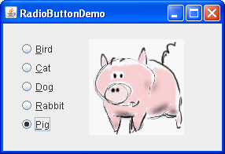
Button group
Radio buttons normally are grouped together
In a radio button group only one of the radio buttons in the group may be selected at any time
The ButtonGroup object creates the mutually exclusive relationship between the radio buttons that it contains

Slide 28
Button group
JRadioButton radio1 = new JRadioButton("Choice 1",
true);
JRadioButton radio2 = new JRadioButton("Choice 2");
JRadioButton radio3 = new JRadioButton("Choice 3");
ButtonGroup group = new ButtonGroup();
group.add(radio1);
group.add(radio2);
group.add(radio3);

Slide 29
Button group
ButtonGroup objects are not containers like JPanel objects, or content frames
If you wish to add the radio buttons to a panel or a content frame, you must add them individually
panel.add(radio1);
panel.add(radio2);
panel.add(radio3);

Slide 30
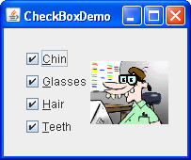
Check boxes
Check appears in box if true
Two JCheckBox constructors:
JCheckBox(String text)
JCheckBox(String text, boolean selected)
Example:
JCheckBox check1 = new JCheckBox("Macaroni");
or
JCheckBox check1 = new JCheckBox("Macaroni", true);

Slide 31
Check boxes
When a JCheckBox object is selected or deselected, it generates an item event
Handling item events is similar to handling action events
When writin an item listener class, the following requirements must be met:
It must implement the ItemListener interface
It must have a method named itemStateChanged
This method must take an argument of the ItemEvent type

Slide 32
Many more components available to be used …

Slide 33
Quick Review Questions
What is GUI based programming?
What is the difference between Swing and AWT?
What is event handling?
What is event listener?
How to handle the event?

Slide 34
Summary of Main Teaching Points
AWT vs Swing
Swing components
Creating a window
Adding components
Handling action events

Slide 35
Q & A

Slide 36
Next Session
File Class
I/O Stream

